Slide 1


Carlos Olivella
February 8, 2023

Slide 2

Outline
Executive Summary
Introduction
Methodology
Results
Conclusion
Appendix

Slide 3
Executive Summary
Summary of methodologies
Data Collection through API
Data Collection through Web Scraping
Data Wrangling
Exploratory Data Analysis with SQL
Exploratory Data Analysis with Data Visualization
Interactive Visual Analytics with Folium and Plotly
Machine Learning Prediction
Summary of all results
Exploratory Data Analysis Result
Interactive Analysis in Screenshots
Predictive Analytics Result

Slide 4
Introduction
Project background and context
SpaceX advertises Falcon 9 rocket launches on its website, costing 62 million dollars; other providers cost upward of 165 million dollars each, much of the savings because SpaceX can reuse the first stage. Therefore, if we can determine if the first stage will land, we can determine the cost of a launch. This information can be used if an alternate company wants to bid against SpaceX for a rocket launch.
Problems you want to find answers
What factors determine if the rocket will land successfully?
The interaction amongst various features that determine the success rate of a successful landing.
What operating conditions need to be in place to ensure a successful landing program?

Slide 5

Section 1

Slide 6
Methodology
Executive Summary:
Data collection methodology:
Data was collected using SpaceX API and Web Scraping from Wikipedia.
Perform data wrangling:
One-hot encoding was applied to Categorical features.
Perform exploratory data analysis (EDA) using visualization and SQL
Perform interactive visual analytics using Folium and Plotly Dash
Perform predictive analysis using classification models:
How to build, tune, and evaluate classification models

Slide 7
Data Collection
Data Collection was done using various methods.
Data collection was done using get request to the SpaceX API.
Next, we decoded the response content as a JSON using .json() function call and turn it into a pandas dataframe using .json_normalize().
We then cleaned the data, checked for missing values, and fill in missing values where necessary.
In addition, we performed web scraping from Wikipedia for Falcon 9 launch records with BeautifulSoup.
The objective was to extract the launch records as an HTML table, parse the table and convert it to a pandas data frame for future analysis.

Slide 8
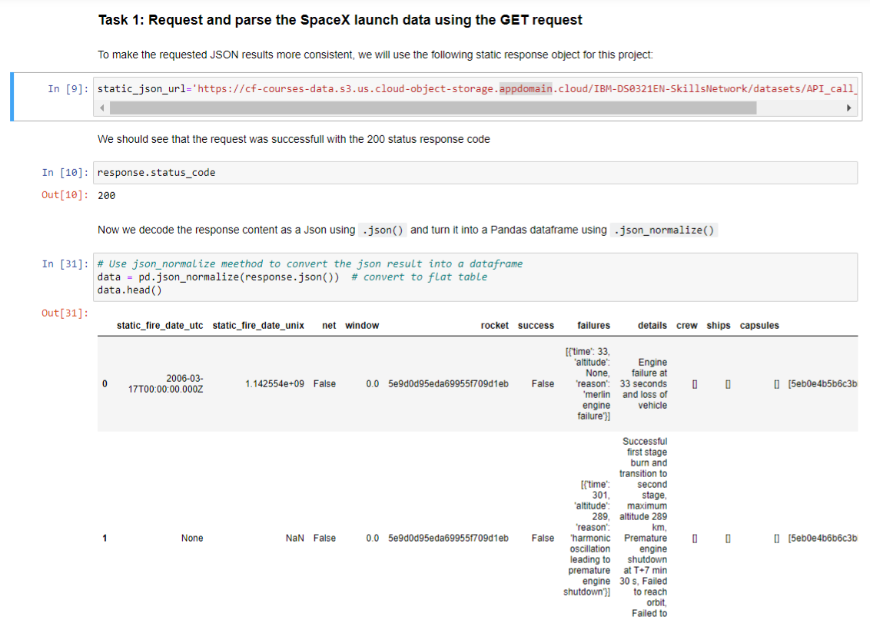
Data Collection – SpaceX API
We used the get request to the SpaceX API to collect data, clean the requested data, and did some basic data wrangling and formatting.

Slide 9
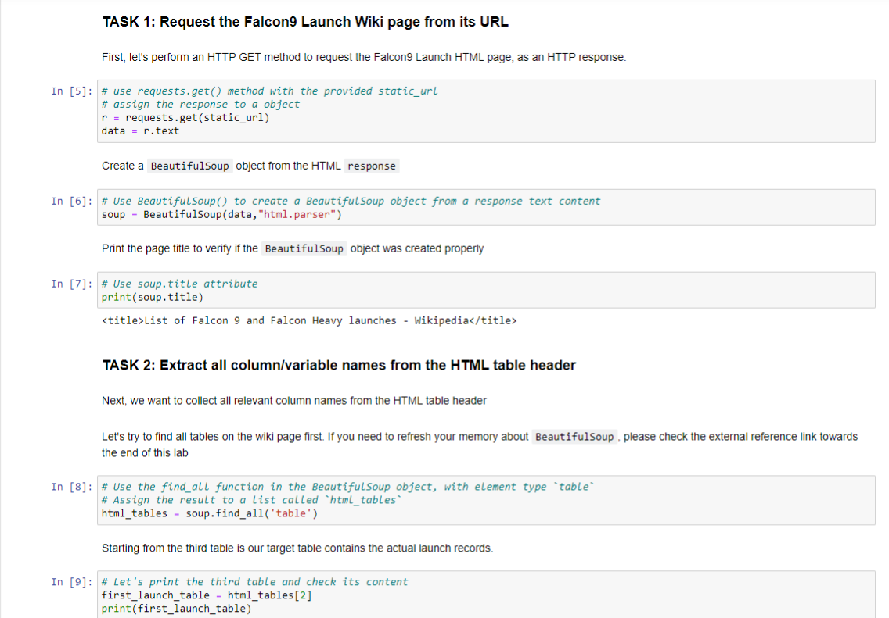
Data Collection - Scraping
We applied web scrapping to web scrap Falcon 9 launch records with BeautifulSoup.
We parsed the table and converted it into a pandas data frame.
The GitHub URL of the completed web scraping notebook.

Slide 10

Data Wrangling
We performed exploratory data analysis and determined the training labels.
We calculated the number of launches at each site, and the number and occurrence of each orbit.
We created a landing outcome label from the outcome column and exported the results to CSV.
The GitHub URL of the completed data wrangling related notebooks

Slide 11
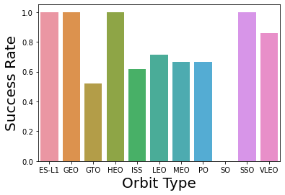
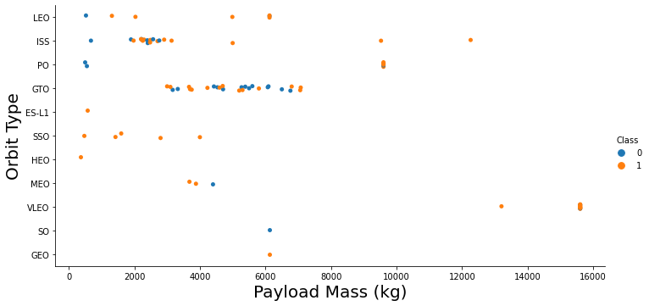
EDA with Data Visualization
We explored the data by visualizing the relationship between flight number and launch Site, payload and launch site, the success rate of each orbit type, flight number and orbit type, and the launch success yearly trend.
The GitHub URL of the completed EDA with Data Visualization notebook.

Slide 12
EDA with SQL
We loaded the SpaceX dataset into a PostgreSQL database without leaving the Jupyter Notebook.
We applied EDA with SQL to get insight from the data. We wrote queries to find out for instance:
The names of unique launch sites in the space mission.
The total payload mass carried by boosters launched by NASA (CRS).
The average payload mass carried by booster version F9 v1.1
The total number of successful and failed mission outcomes.
The failed landing outcomes in drone ship, their booster version, and launch site names.

Slide 13
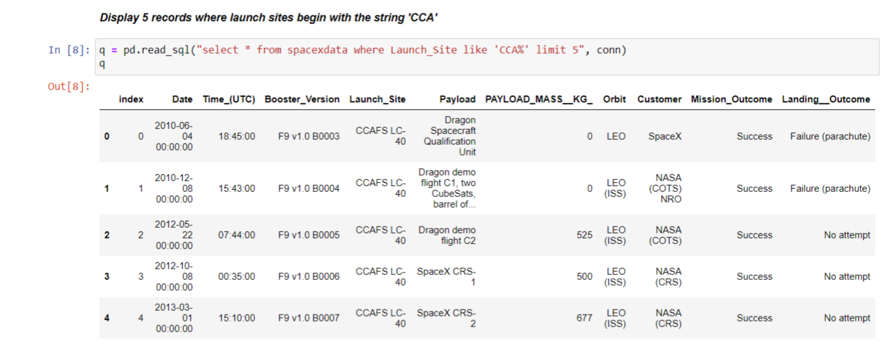
EDA with SQL
The GitHub URL of the completed EDA with SQL-related notebooks.

Slide 14
Build an Interactive Map with Folium
We marked all launch sites and added map objects such as markers, circles, and lines to mark the success or failure of launches for each site on the folium map.
We assigned the feature launch outcomes (failure or success) to classes 0 and 1. i.e., 0 for failure, and 1 for success.
Using the colored marker clusters, we identified which launch sites have a relatively high success rate.
We calculated the distances between a launch site to its proximities.
We answered some questions for instance:
Are launch sites near railways, highways, and coastlines?
Do launch sites keep a certain distance away from cities?

Slide 15
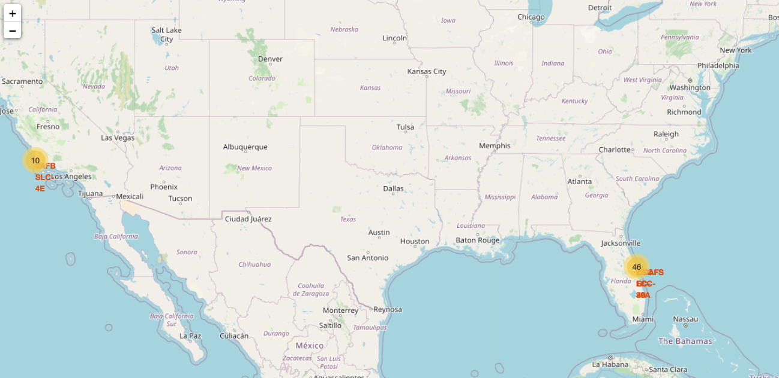
Build an Interactive Map with Folium
The GitHub URL of the completed Interactive map with Folium-related notebooks.

Slide 16
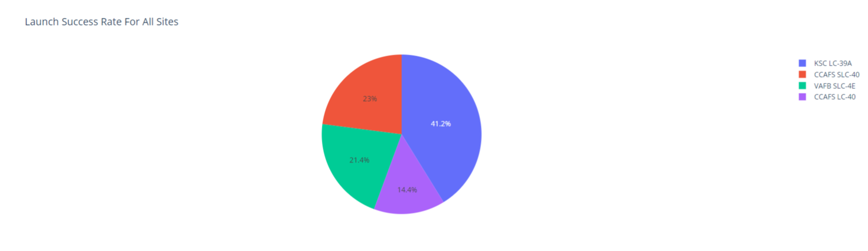
Build a Dashboard with Plotly Dash
We built an interactive dashboard with Plotly dash.
We plotted pie charts showing the total launches by a certain site.
We plotted a scatter graph showing the relationship between Outcome and Payload Mass (Kg) for the different booster versions.
The GitHub URL of the completed Dashboard with Plotly-related notebooks

Slide 17
Predictive Analysis (Classification)
We loaded the data using NumPy and pandas, transformed the data, and split our data into training and testing.
We built different machine learning models and tune different hyperparameters using GridSearchCV.
We used accuracy as the metric for our model and improved the model using feature engineering and algorithm tuning.
We found the best performing classification model.
The GitHub URL of the completed best-performing Classification Model-related notebook.

Slide 18
Results
Exploratory data analysis results
Interactive analytics demo in screenshots
Predictive analysis results

Slide 19

Section 2

Slide 20
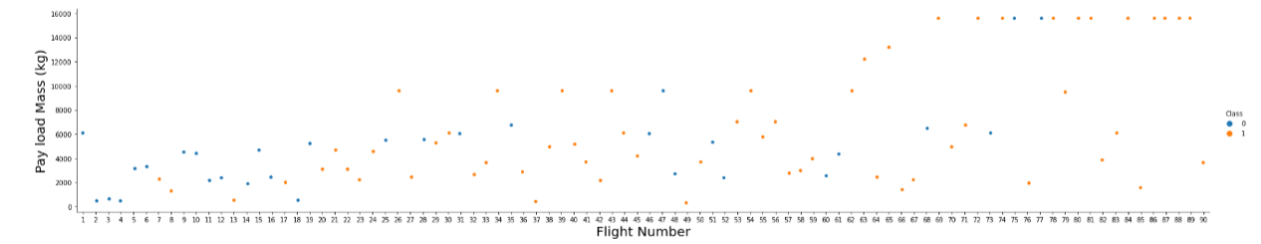
Flight Number vs. Launch Site
From the plot, we found that the larger the flight amount at a launch site, the greater the success rate at a launch site.

Slide 21
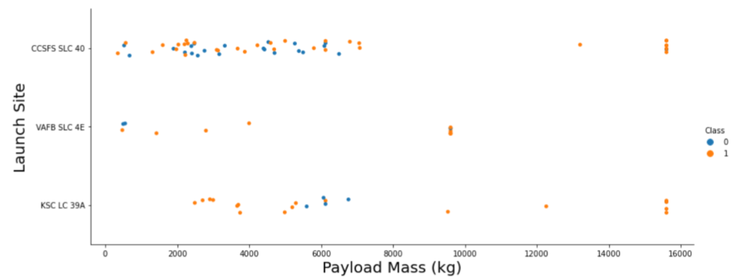
Payload vs. Launch Site
Now if you observe Payload Vs. Launch Site scatters point chart you will find for the VAFB-SLC launch site there are no rockets launched for heavy payload mass(greater than 10000).

Slide 22
Success Rate vs. Orbit Type
From the plot, we can see that ES-L1, GEO, HEO, SSO, and VLEO had the most success rate

Slide 23
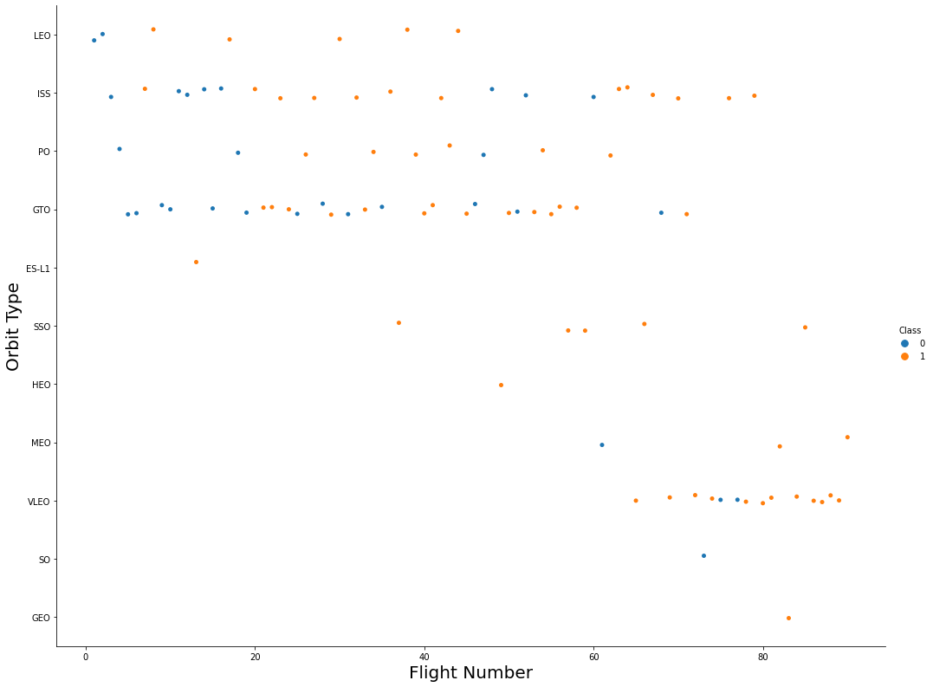
Flight Number vs. Orbit Type
The plot below shows the Flight Number vs. Orbit type. We observe that in the LEO orbit, success is related to the number of flights whereas in the GTO orbit, there is no relationship between flight number and the orbit.

Slide 24
Payload vs. Orbit Type
We can observe that with heavy payloads, the successful landing is more for PO, LEO, and ISS orbits.

Slide 25
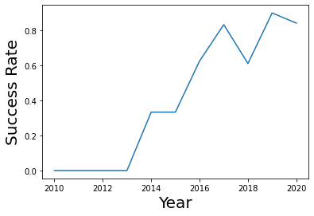
Launch Success Yearly Trend
From the plot, we can observe that the success rate since 2013 kept on increasing till 2020

Slide 26
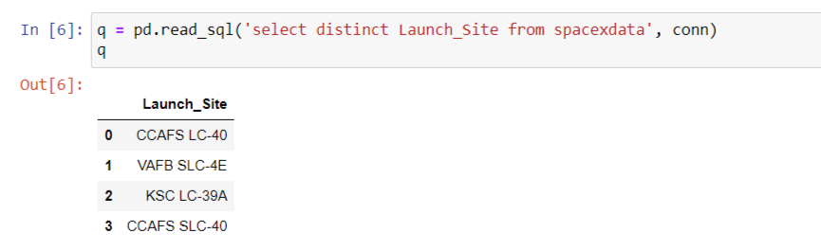
All Launch Site Names
We used the keyword DISTINCT to show only unique launch sites from the SpaceX data.

Slide 27
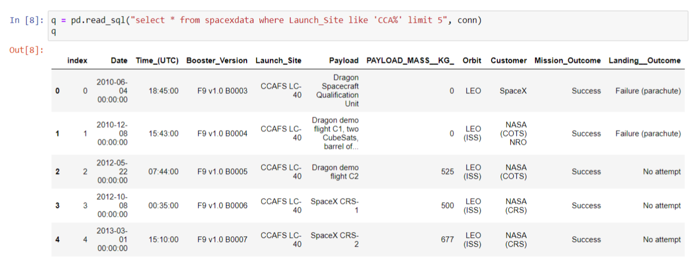
Launch Site Names Begin with 'CCA'
We used the query above to display 5 records where launch sites begin with `CCA`.

Slide 28
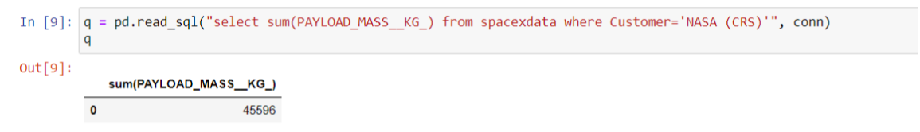
Total Payload Mass
We calculated the total payload carried by boosters from NASA as 45596 using the query below

Slide 29
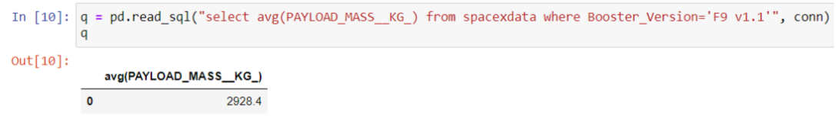
Average Payload Mass by F9 v1.1
We calculated the average payload mass carried by booster version F9 v1.1 as 2928.4

Slide 30
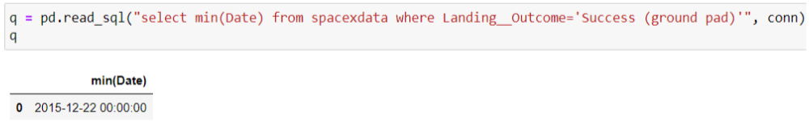
First Successful Ground Landing Date
We observed that the date of the first successful landing outcome on the ground pad were 22nd December 2015.

Slide 31
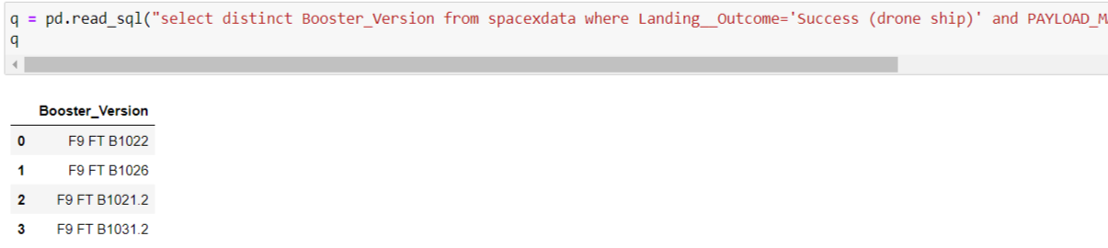
Successful Drone Ship Landing with Payload between 4000 and 6000
We used the WHERE clause to filter for boosters that have successfully landed on a drone ship and applied the AND condition to determine a successful landing with a payload mass greater than 4000 but less than 6000

Slide 32
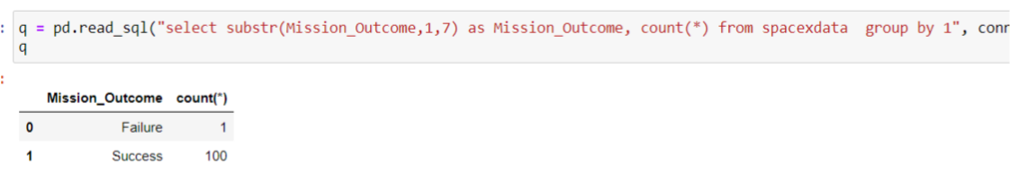
Total Number of Successful and Failure Mission Outcomes
We used wildcards like ‘%’ to filter for WHERE Mission Outcome was a success or a failure.

Slide 33
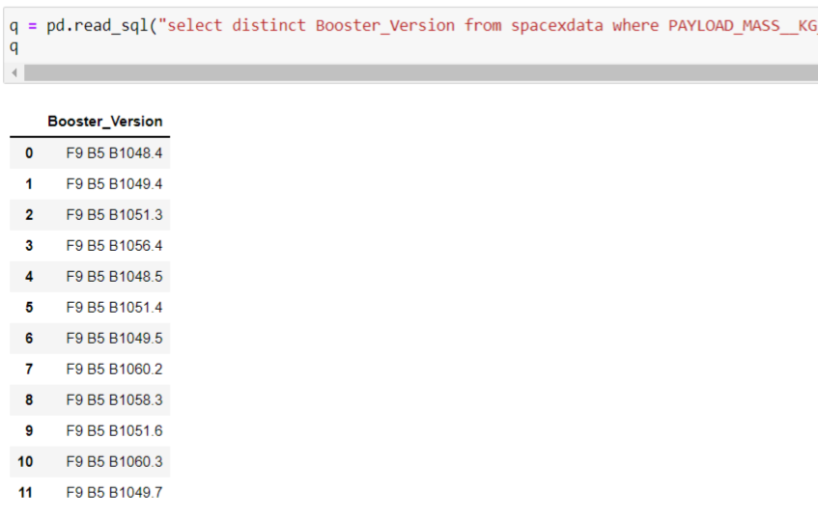
Boosters Carried Maximum Payload
We determined the booster that has carried the maximum payload using a subquery in the WHERE clause and the MAX() function.

Slide 34
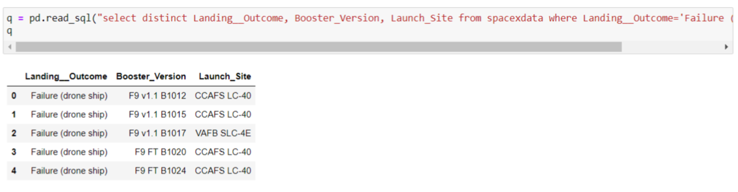
2015 Launch Records
We used a combination of the WHERE clause, LIKE, AND, and BETWEEN conditions to filter for failed landing outcomes in drone ship, their booster versions, and launch site names for the year 2015.

Slide 35
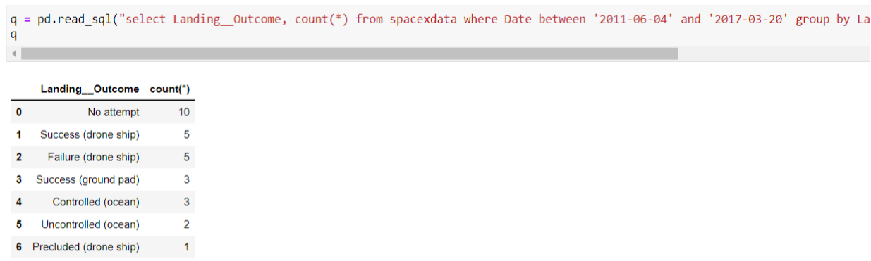
Rank Landing Outcomes Between 2010-06-04 and 2017-03-20
We selected Landing outcomes and the COUNT of landing outcomes from the data and used the WHERE clause to filter for landing outcomes BETWEEN 2010-06-04 to 2010-03-20.
We applied the GROUP BY clause to group the landing outcomes and the ORDER BY clause to order the grouped landing outcome in descending order

Slide 36

Section 3

Slide 37
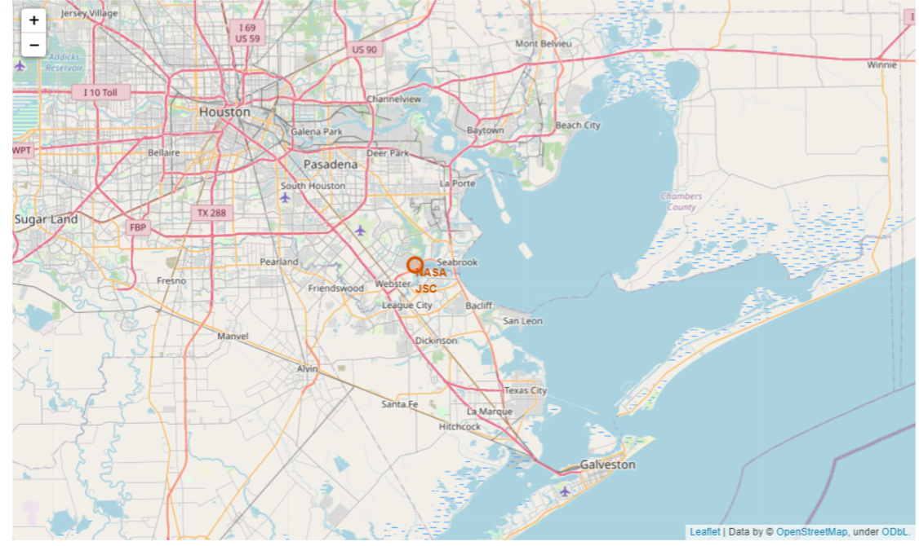
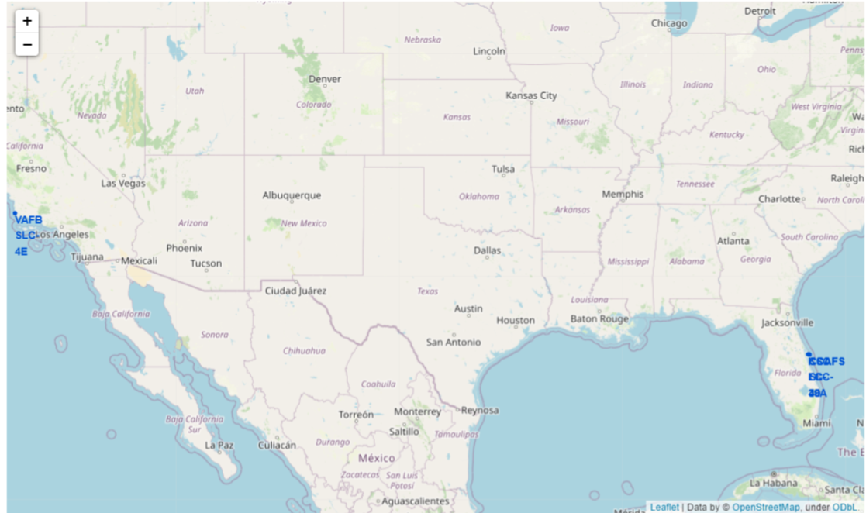
All Launch Sites Global Map Markers
We used folium. Circle to add a highlighted circle area with a text label on a specific coordinate
We can see that the SpaceX launch sites are in Coastal regions of the United States of America.

Slide 38

Markers showing launch sites with color labels

Slide 39
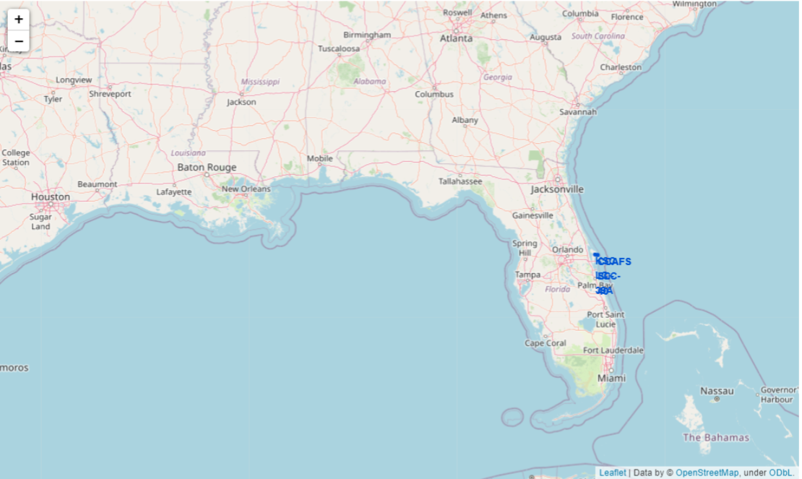

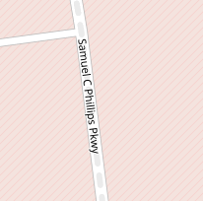


Launch Site distance to landmarks

Slide 40

Section 4

Slide 41
Pie chart showing the success percentage achieved by each launch site
We can see that KS LC-39A had the most successful launches from all sites.

Slide 42
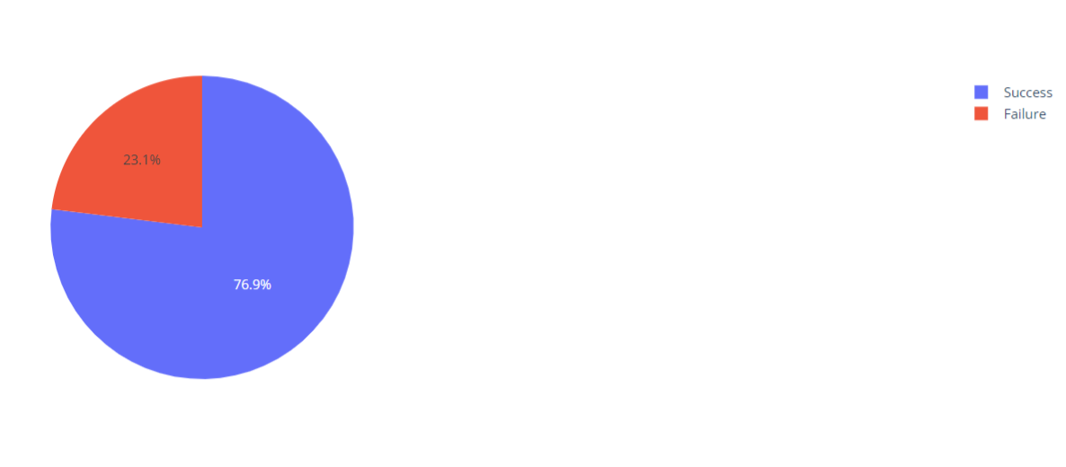
Pie chart showing the Launch site with the highest launch success ratio
KSC LC-39A achieved a 76.9% success rate while getting a 23.1% failure rate.

Slide 43
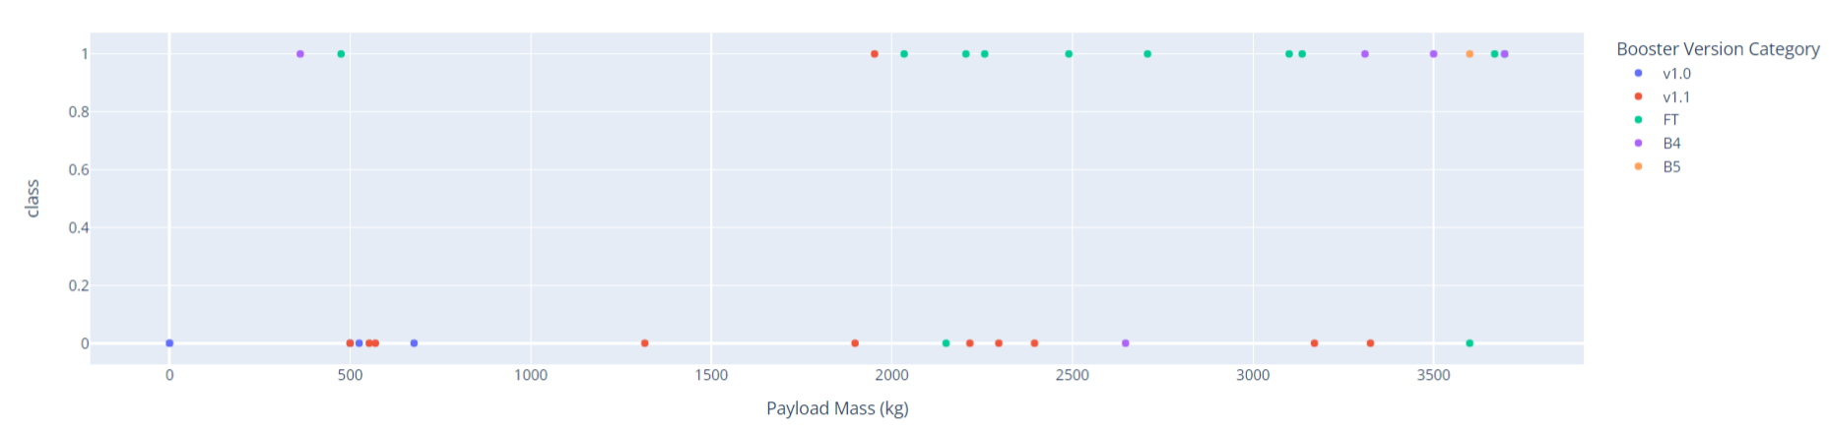
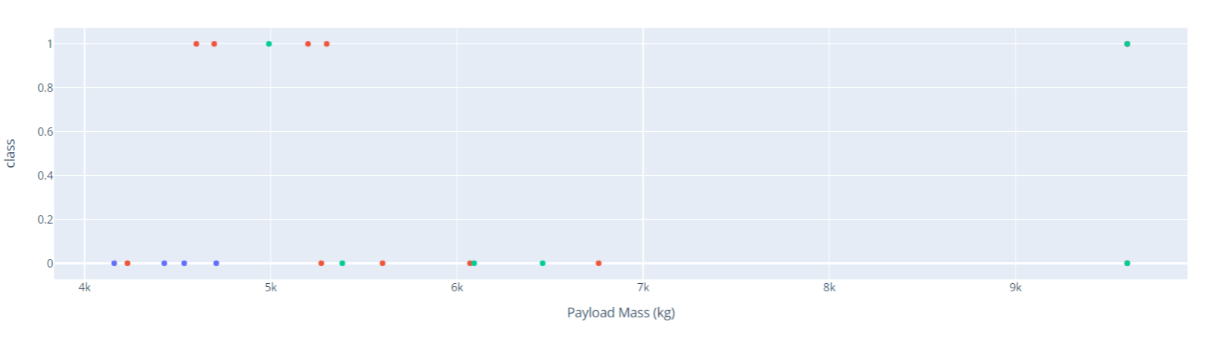
Scatter plot of Payload vs Launch Outcome for all sites, with different payload selected in the range slider
We can see the success rates for low payloads higher than heavily weighted payloads.

Slide 44

Section 5

Slide 45
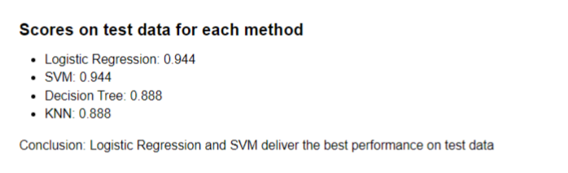
Classification Accuracy
The Logistic Regression and SVM are the models with the highest Classification Accuracy.

Slide 46
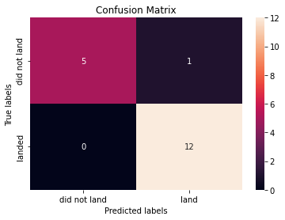
Confusion Matrix
The confusion matrix for the Logistic Regression shows that the classifier can distinguish between the different classes. The major problem is the false positives. i.e., an unsuccessful landing is marked as a successful landing by the classifier.

Slide 47
Conclusions
We can conclude that:
The larger the flight amount at a launch site, the greater the success rate at a launch site.
Launch success rate started to increase from 2013 till 2020.
Orbits ES-L1, GEO, HEO, SSO, and VLEO had the most success rate.
KSC LC-39A had the most successful launches of any site.
The Logistic Regression classifier is the best machine learning algorithm for this task.

Slide 48


